Slide 1
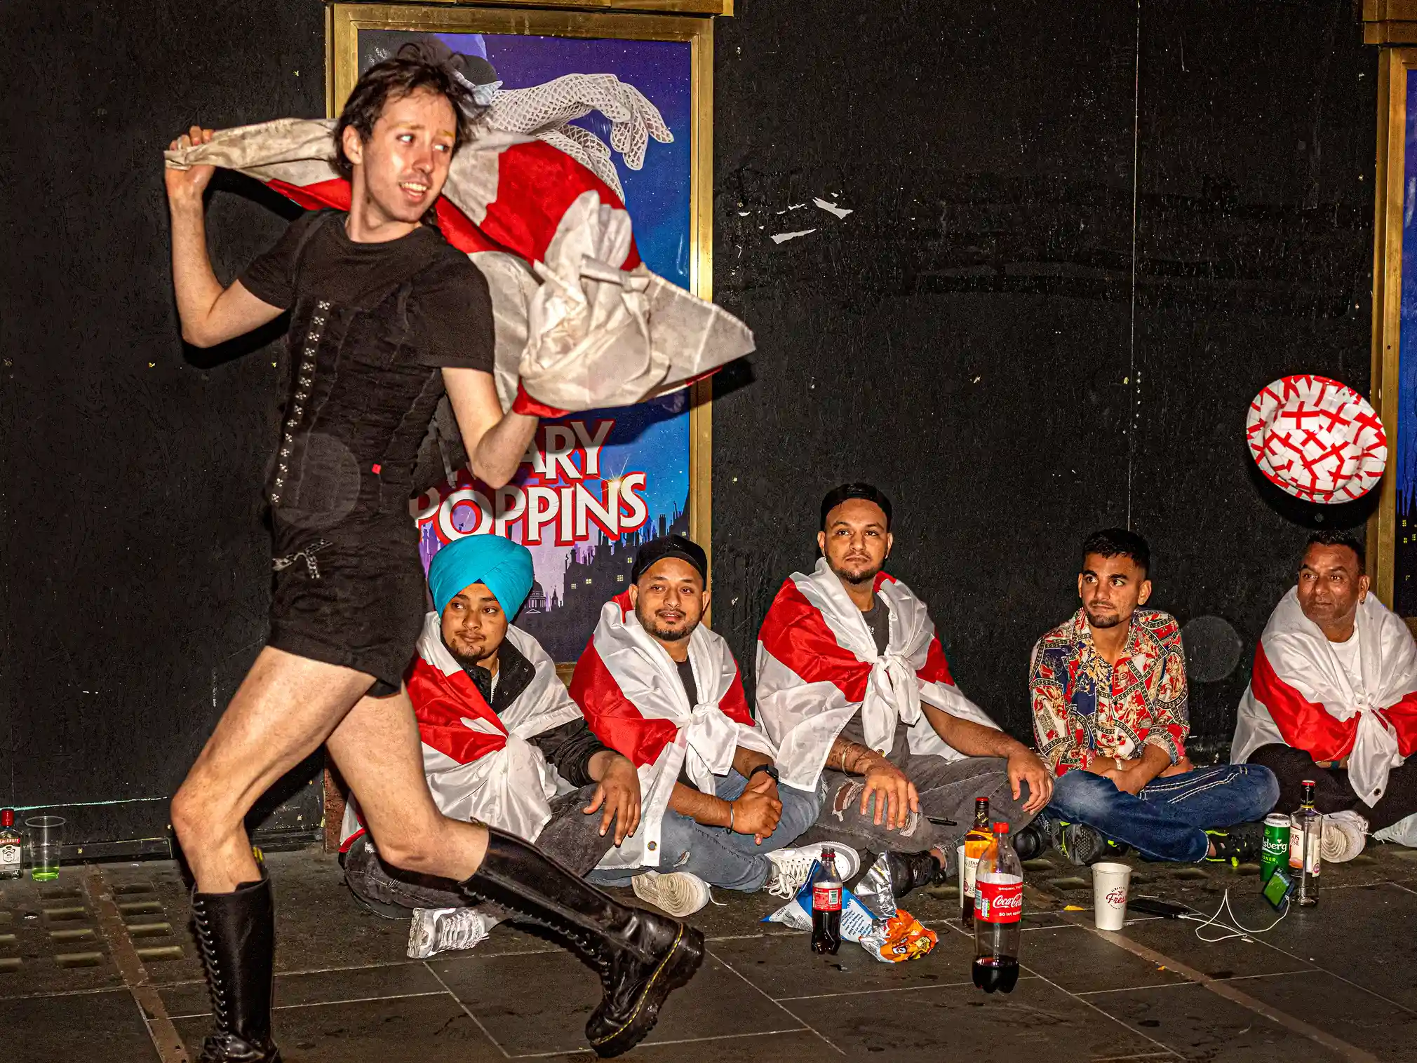
Cruising Texts: A Radical Project for Student-to-Student Peer REview
Introduction – Why Peer Review, Why Now?
Chapter 1 – Breaking the Back of Peer Review
Chapter 2 – Queer Worldmaking and Contingent Intimacy
Chapter 3 – A Slow Praxis for Peer Review
Chapter 4 – Messy Methods and Messier Assessments
Conclusion – Toward Imagined Futures for Intimate Praxis
Photograph by Dougie Wallace; 25 August 2022

