Slide 1
Bayside Expo Development
A Basic Overview
MS in Urban Planning and Community Development
UMass Boston

Slide 2
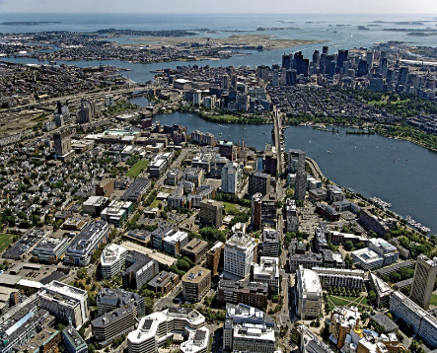
The Project
The UMass Board of Trustees and UMass Building Authority voted on February 14, 2019 to designate Accordia Partners LLC the lead developer (99- year ground lease) to transform the 19.94 acre former Bayside Expo Site into a mixed-used urban innovation district inspired, in part, by Kendall Square at MIT, in Cambridge

Slide 3
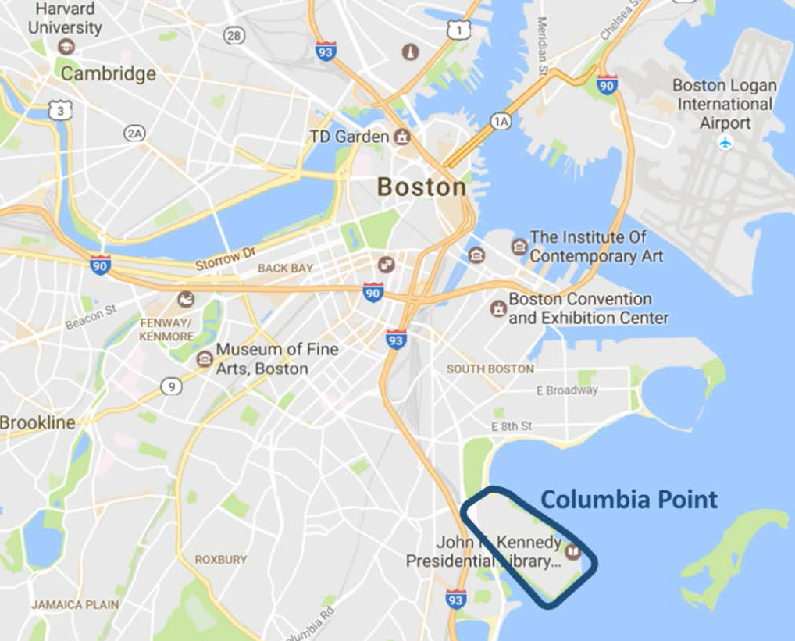
Extremely Valuable Property
Large site, close to the CBD, on the water, good transportation/transit connections, one public owner, considerable nearby public/private investment
Minutes to Boston landmarks
from Bayside Property
Fenway Park
MIT
13 Logan Airport
Convention Center
11 Boston City Hall
UMass Boston
Campus

Slide 4
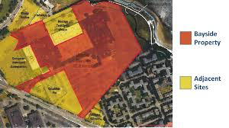
Proposed Scale and Uses
Accordia has proposed 3-3.5 million sq. ft. of new space
The preliminary project description features residential, life sciences, academic office, retail, and public uses
Housed in twenty to thirty story buildings constructed on the buildable portion of the site
Lower building heights proposed for the water’s edge, higher densities closer to Mt. Vernon
Developers face significant constraints due to: waterfront, landfill, flight path, and utility easements

Slide 5
Square Footage Equal to World Trade Tower in NYC
More square footage than the Empire State Building (2.9 million)
Equal to the World Trade Center (3.5 million)

Slide 6
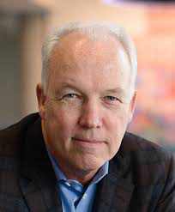
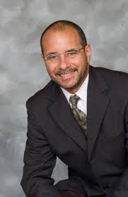
The Developers
Accordia Partnership LLC was formed on 2014
Principals are Richard Galvin, long-time Boston developer, and Keith Sykes, a Cornell trained architect and former Federal Reserve Board of Boston Member
They qualify as a Minority Business Enterprise
This would be the firm’s largest project to date

Slide 7
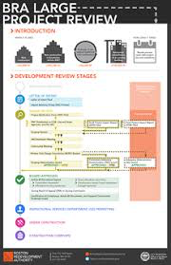
Planning Process
Project requires significant zoning changes
Developers have decided to pursue these through the City’s Article 80 process
This official BPDA sanctioned review process would begin in January
Currently, they are doing outreach to local community-based organizations
Recently they worked with four local civic associations to hold two charettes – attendance was good, although not representative

Slide 8
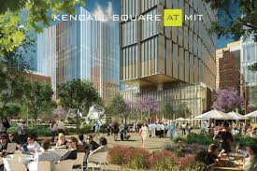
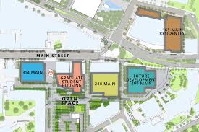
Potential Benefits
Transform an overflow parking area into a potentially vibrant district
Provide needed space for Boston’s rapidly expanding service economy
Support job creation within the City’s ever expanding knowledge economy
Taxes and fees – maybe?
Produce between $200 to $230 million in revenue to help UMB address its legacy debts

Slide 9
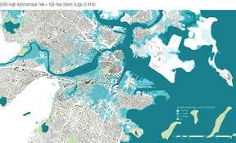
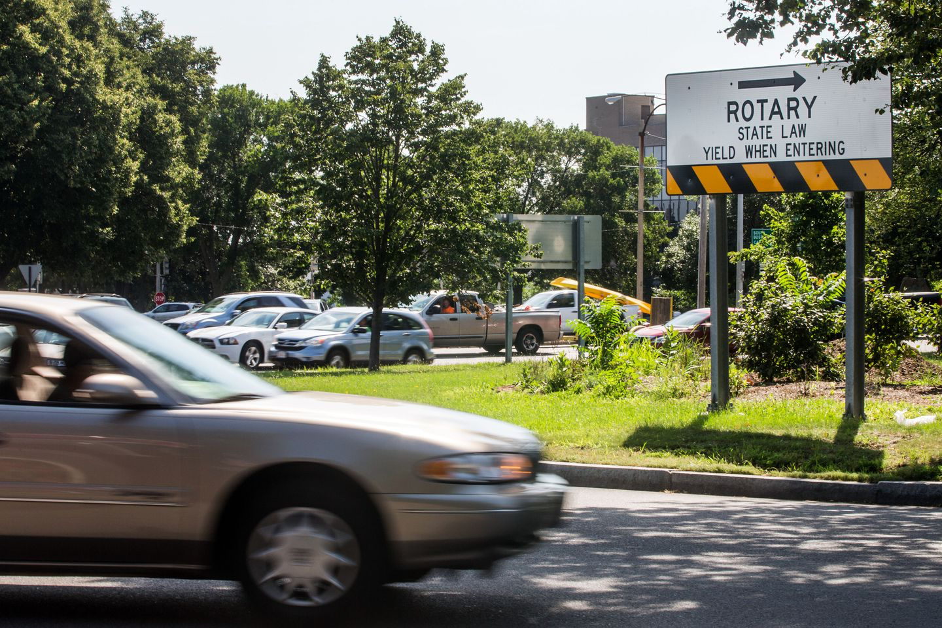
Significant Challenges
UMB loses a significant portion of its expansion space
Susceptible to climate change related sea rise
Exacerbate existing traffic congestion (Morrissey, K Circle, and Day Boulevard)
Accelerate residential and commercial displacement in Dorchester and South Boston
Another income segregated enclave similar to Kendall Square and the Innovation District
Integrate the new district into the existing community fabric so it enhances quality of life for all

Slide 10
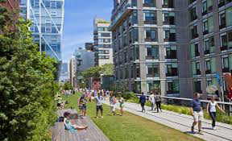
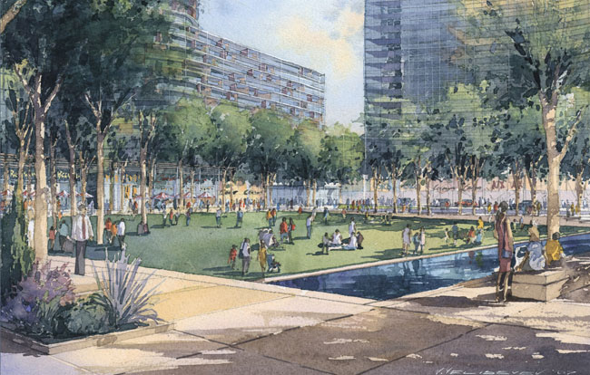
Gentrification Social Segregation

Slide 11
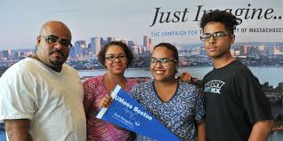
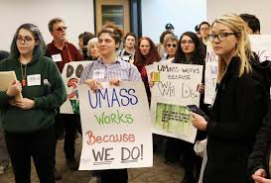
Our Stewardship Responsibilities
Insure open and transparent planning process
Strive to be a model of resiliency planning
Undertake a social benefit cost analysis so externalities can be identified and mitigated
Emphasize transportation alternatives
Advance socially integrated/family-cycle housing on-site
Maximize employment for Section 8 eligible residents
Subsidized space for community businesses and non profits
Encourage an inspired urban design for the site

Slide 12
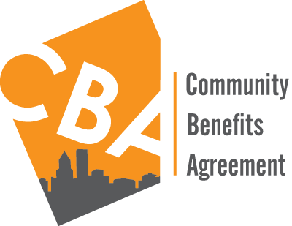
Seeking a Just Outcome
Ask local officials to require the developer to enter into a community-benefits agreement with residents before taking the project through BPDA’s Article 80 process
Insure the previously mentioned issues are explicitly addressed in the scoping phase of the Article 80 process

Slide 13
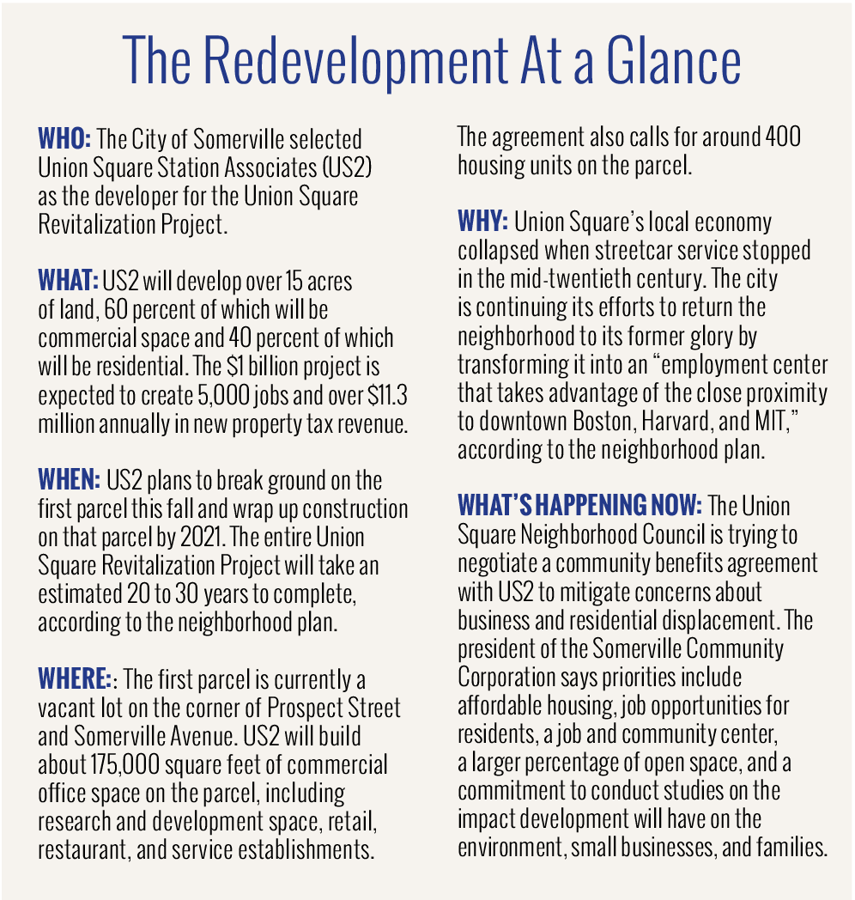

Slide 14
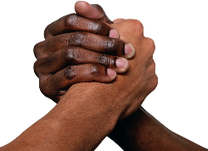
Are we willing to risk undermining our long-standing relationship with poor, working-class, and middle income Bostonians, our traditional political base, in a Commonwealth dominated by private higher educational institutions in an effort to partially resolving the campus’ financial problems?
55 years of social capital created by “doing the work” put at risk
$230 million

